Slide 1
Secondary Features
Tertiary Features
User Account
Deactivate Account
Quotation
Digital Signature
Generate Default
Quotation by Selection
Invoice
Digital Signature
Contract
Digital Signature
Sign-off
Digital Signature
Bug Reporting
Digital Signature
OPTIONAL Features
Primary Features
Staff
Deactivate Staff
Generate & View
Staff Portfolio
Contract
Download/Generate
in PDF
Deactivate Contract
Email to Client
Project
CRUD using Trello
Browse Tasks
Project Schedule
Sort Tasks
Create Dashboard
Create Simulation
Quotation
Create/Edit/View
Quotation
Create/Edit/View
Quotation with
Preset Modules
Create Payment
Plan
Staff Portfolio
View Staff Portfolio
Filter Project by Status
View Project
Deactivate Staff
Portfolio
User Account
Time-based Security
User Access Control
Master Setup
Edit template
Create/Edit/Delete
Preset Quotation
Module Name
& Price Range
Invoice
Download/Generate in PDF
Deactivate Invoice
Email to Client
User Account
Login/Logout
Create/Edit
Account
Password Reset
Quotation
Invoice
Contract
Sign-off
Bug Reporting
Optimization
Enhance User Interface
Update APIs
Dynamic Page Replacing
Content
Invoice
Create/Edit/
View Invoice
Sign-off
Create/Edit/
View Sign-off
Sign-off
Download/Generate in PDF
Deactivate Sign-off
Email to Client
Quotation
Download/Generate
in PDF
Deactivate Quotation
Email to Client
Project
Export to CSV
Staff
Create/Edit Staff
Contract
Create/Edit/
View Contract
Bug Logbook
Create/Edit/
View Bug Logbook
Bug Logbook
Download/Generate in PDF
Deactivate Bug Form
Client Portfolio
Create/View Client Portfolio
Update Client Portfolio
View Client’s Project Info
Export to CSV
Project Tasks
CRUD using Trello
NDA
Create/Edit/
View NDA
Quotation
Export to CSV
Project
Logging
Integrate Resource
to Dashboard
NDA
Download/Generate in PDF
Deactivate Sign-off
Email to Client
Invoice
Export to CSV
Product
Create/Edit/View
Product Info
Integration
Integrate with one
communication
platform
Hardware Resource
Create/Edit/
View Hardware
Resource
Business Intelligence
Generate Charts/Reports Staff
Contribution, Progresses of
Projects, Skill Sets and Average
Number of New Projects Every
Month
Hardware Resource
Assign Resource
to Project
Notes:
Editable format.

Slide 2
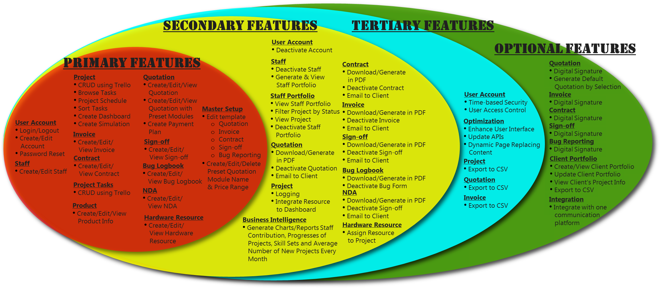
Notes:
Picture format.

